Slide 1
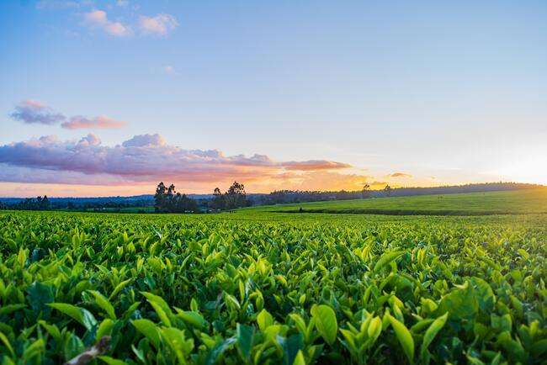

ANNAMACHARYA INSTITUTE OF TECHNOLOGY AND SCIENCES
(AUTONOMOUS),RAJAMPET
APP QUEST Boot Camp
IDEA
PRESENTED BY:-
TEAM NAME:-(THE DREAM CATCHERS.)
NAME ROLL NO:-
P.Neeraja (21701A04A1)
D.Meghana (21701A0485)
B.Lahari (21701A0467)
K.Mohanbabu (21701A0488)
K.Muralikrishna (21701A0492)

Slide 2
AgriConnect: Empowering Farmers and Buyers Through Seamless Crop Marketing

Slide 3
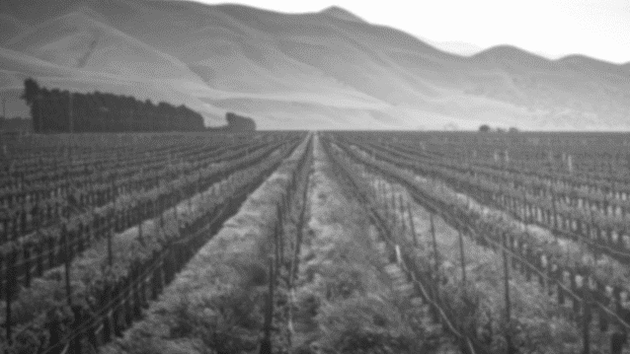
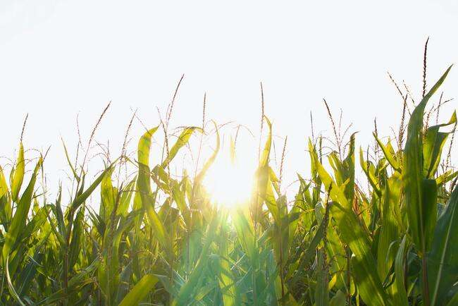
CONTENTS
01
Key Features
User Profiles. Marketplace.
Crop Listings. Order & Payment System.
Rating & Review System.
02
Tech Stack
Frontend.
Backend.
Payment Integration
03
Steps to Develop the App
Planning. Design.
Development. Testing.
Launch & Marketing
04
Monetization Options
Commission. Subscription.
Ads. Logistics Partnerships

Slide 4
Problem Statement
The agricultural sector, especially for small and medium-scale farmers, faces significant challenges in connecting with
reliable buyers and achievingfair market prices for their produce. The traditional crop marketing system is often plagued
by several issues:
Limited Market Access: Farmers, particularly in rural areas, have limited access to potential buyers, restricting their ability
to sell crops at competitive prices.
Price Instability and Lack of Transparency: Due to middlemen and a lack of transparent pricing, farmers often receive lower
payments, while buyers face inconsistent pricing and limited information on quality and availability.
Information Gap: There is insufficient real-time data about market trends, crop demand, and pricing, preventing farmers
from making informed decisions regarding planting, harvesting, and selling.
Logistical and Distribution Issues: Complex logistics make it challenging for farmers to efficiently transport their produce to
buyers, leading to post-harvest losses and increased costs.
Fragmented Supply Chain: The absence of a streamlined connection between farmers, logistics providers, and buyers leads
to inefficiencies that hinder profitability and productivity.
Impact:
Farmers are unable to maximize income, leading to economic instability.
Buyers struggle to find reliable, quality sources of produce at fair prices, affecting their operations.

Slide 5
Solution Statement
AgriConnect is a digital platform bridging the gap between farmers and buyers for transparent crop marketing.
How AgriConnect Solves the Problem:
Direct Connection: Online marketplace for farmers to list produce and buyers to place orders, eliminating intermediaries.
Real-Time Market Data: Provides up-to-date crop prices, demand trends, and historical data for informed decision-making.
Streamlined Logistics: Connects farmers with reliable transportation services for efficient crop delivery and reduced
post-harvest losses.
User-Friendly Experience: Intuitive interface with multi-language support for easy navigation and communication.
Secure Transactions: Multiple secure payment options reduce risks associated with traditional cash transactions.
Impact:
For Farmers: Direct market access, fair pricing, and reliable logistics lead to increased income and economic stability.
For Buyers: Access to diverse, high-quality produce at competitive prices and reduced supply chain complexity.

Slide 6

01
Key Features
The crop marketing app connects farmers and buyers through personalized profiles, allowing farmers to list their crops and buyers to easily search and filter listings. It features secure payments, real-time notifications, and in-app messaging for seamless communication, while a rating system builds trust within the community.

Slide 7

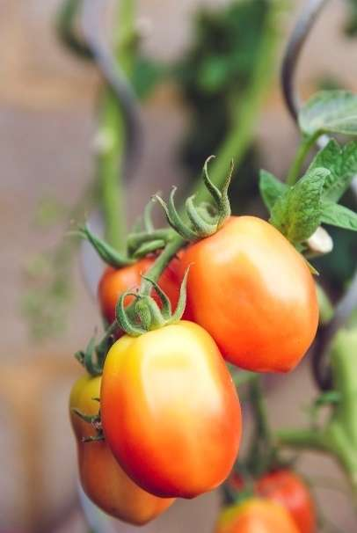

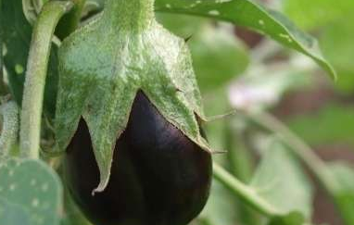
Key Features:-
The crop marketing app provides user profiles for farmers to showcase their crops and allows buyers to browse and purchase directly, enhancing personalization. Farmers can list details such as crop type, quantity, price, and images, while buyers can filter and search for specific products.
The app features a user-friendly marketplace interface for comparing crop listings, with options to sort by price, location, and type. Secure payment methods and integrated maps simplify transactions and logistics for fresh produce pickup or delivery.
Users receive real-time notifications about new listings, price changes, and order statuses. An in-app messaging system facilitates direct communication between farmers and buyers, while a rating and review system fosters trust and reliability within the community.

Slide 8

Key Features
Objectives 1
Objectives 3
Facilitate Communication and Trust: In-app messaging and a rating and review system aim to promote transparency and direct communication between farmers and buyers, building a reliable community and ensuring quality interactions.
Enhance User Engagement: By providing personalized profiles for farmers and buyers, the app aims to foster strong connections and interactions, encouraging frequent usage and engagement with the platform.
Objectives 2
Objectives 4
Streamline Transactions: The app’s marketplace interface, secure payment options, and geolocation features are designed to simplify the buying and selling process, making it easy for users to find, compare, and purchase fresh produce efficiently.
Keep Users Informed: Real-time notifications about new listings, price changes, and order statuses are intended to keep users updated and informed, enhancing the overall user experience and ensuring they never miss important information.

Slide 9
02
Tech Stack
The crop marketing app uses React Native for mobile development, Node.js for the backend, and PostgreSQL for database management. It employs Google Cloud for hosting and integrates Stripe or PayPal for secure payments.
.

Slide 10





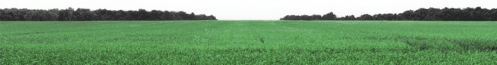
Tech Stack
Step 1
Step 2
Step 3
Frontend Development:
Utilize React Native for cross-platform mobile app development, ensuring compatibility with both iOS and Android.
Design a clean, minimalistic user interface using Figma for prototyping and modern design principles.
^{Backend Development:}
Implement server-side operations using Node.js or Django (Python) to manage application logic and data processing.
Choose PostgreSQL for the database to store user profiles, crop listings, and transaction data efficiently.
Cloud Services and Payment Integration:
Host the application onGoogle Cloud for scalable backend support, utilizing Firebase for push notifications and real-time data synchronization.
Integrate payment gateways like Stripe, PayPal, or region-specific solutions to facilitate secure transactions within the app.

Slide 11
FRONTEND DESIGN
Homepage: A clean and welcoming landing page with a search bar for buyers to find crops and for farmers to list their produce.
Farmer Dashboard: A user-friendly interface where farmers can manage their crop listings, view orders, and track payments.
Buyer Dashboard: A dashboard for buyers to browse available crops, place orders, and manage transactions.
Crop Listings: Detailed pages for each crop with information like price, quantity, location, and seller ratings.
Order Management: A streamlined process for placing, tracking, and confirming orders.
Notifications: Real-time alerts for order updates, new crop listings, and messages from other users.
Profile Management: Easy-to-use profile settings for farmers and buyers to update their information and preferences.
Marketplace: A dynamic marketplace where buyers and sellers can interact, negotiate prices, and finalize deals.
Analytics: Visual dashboards showing trends, sales data, and market insights to help users make informed decisions.
Mobile Responsiveness: Ensure the design is mobile-friendly, allowing users to access the platform on their smartphones and tablets.

Slide 12
Steps to Develop the App
03
Develop the crop marketing app by conducting market research, designing user-friendly wireframes, and developing the frontend and backend in an agile manner. Test for usability and performance, then launch a beta version to gather feedback. Finally, implement a marketing strategy, provide user support, and monitor app performance for ongoing improvements.

Slide 13

Steps to Develop the App
Objectives 1
User-Centric Design: Conduct market research to define user personas and create user-friendly wireframes that prioritize usability and offline access for farmers.
Objectives 2
Agile Development: Develop the frontend and backend in parallel using an agile approach, focusing on key features to create a minimum viable product (MVP).
Objectives 3
Comprehensive Testing: Perform thorough usability and performance testing to ensure the app functions seamlessly on both iOS and Android devices before launching a beta version.
Objectives 4
Feedback and Support: Launch the app, gather user feedback for continuous improvements, implement a marketing strategy, and provide ongoing support to enhance user experience.

Slide 14
User Experience Flow
Registration and Onboarding:
Create an account easily.
Onboarding tutorial to guide users through features.
Profile Setup:
Complete profiles with location and business details.
Farmers upload certifications to enhance credibility.
Listing Products (for Farmers):
Farmers list products by entering crop details and images.
Prompts ensure accurate listings.
Searching and Browsing (for Buyers):
Buyers search or browse for crops easily.
Filters refine searches by location, price, and type.
Viewing Product Details:
Buyers see detailed descriptions and reviews.
Real-time availability and pricing are shown.
Placing Orders:
Buyers add products to cart and checkout smoothly.
Secure payment options available.
Order Confirmation and Tracking:
Users get confirmation and can track orders in real-time.
Notifications for shipment and delivery updates.
Customer Support:
Access support for inquiries or technical issues.
Help resources like FAQs and chat support are available.

Slide 15
04
Monetization Options
The crop marketing app connects farmers directly with buyers, enabling seamless transactions for fresh produce. It features user-friendly crop listings, secure payment options, and real-time notifications, promoting transparency and market access. The app aims to enhance the agricultural community by benefiting both producers and consumers.

Slide 16
Monetization Options
Objectives 1
Objectives 3
Commission: Implement a commission-based model by charging a percentage on every successful transaction between farmers and buyers, generating revenue with each sale.
Subscription: Offer premium subscription plans that provide users with additional features, such as enhanced listings, advanced analytics, and priority customer support for a monthly or yearly fee.
Objectives 2
Objectives 4
Ads: Integrate targeted advertising within the app for agricultural products, machinery, and services, allowing businesses to reach a relevant audience while generating ad revenue.
Logistics Partnerships: Establish partnerships with logistics providers and charge fees for delivery services booked through the app, creating a streamlined experience for users while generating additional income.

Slide 17
THANKS FOR WATCHING

